Slide 1
PERFORMANCE MODELING AND SUITABILITY ASSESSMENT OF DATA CENTER BASED ON FOG COMPUTING IN SMART SYSTEMS
INDHU.P
CLASS NO:29 S7 Btech CSE
Dept. of CSE,MACE Kothamangalam
September 12,2018

Slide 2
CONTENTS
PERFORMANCE MODELING AND SUITABILITY ASSESSMENT OF DATA CENTER BASED ON FOG COMPUTING
INTRODUCTION
IOT
CLOUD COMPUTING
CHALLENGES OF CC
FOG
THREE TIER ARCHITECTURE
NETWORK MODEL
PERFORMANCE MODELING
APPLICATIONS

Slide 3
IOT
PERFORMANCE MODELING AND SUITABILITY ASSESSMENT OF DATA CENTER BASED ON FOG COMPUTING
Internetworking of physical devices
Transfer of data without Human to human
Human to computer interaction
The number of IOT devices increased 8.4 billion (2017)
There will be 30 billion devices by 2020
Number of connected vehicles =>250 millions (2020)
Data generated by IOT devices is huge

Slide 4
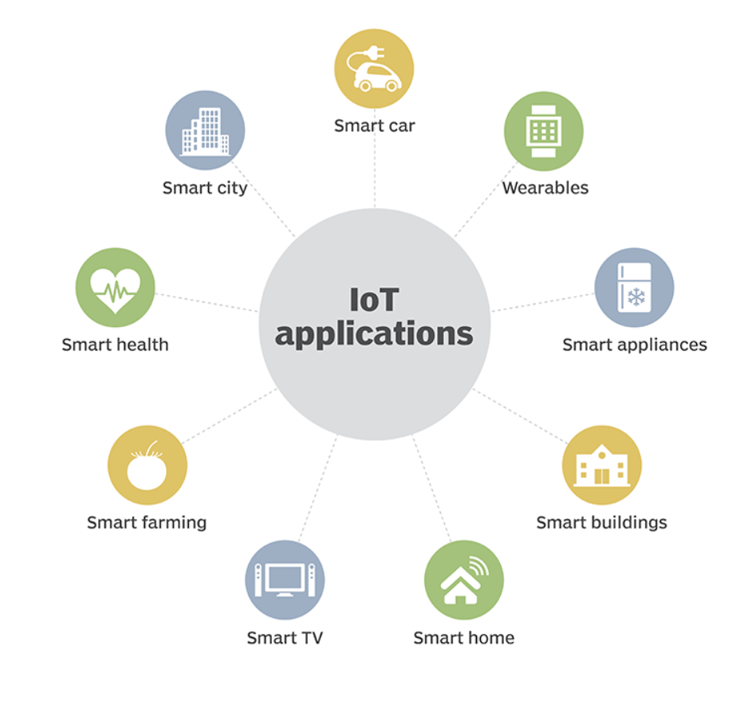
IOT (cont.)
PERFORMANCE MODELING AND SUITABILITY ASSESSMENT OF DATA CENTER BASED ON FOG COMPUTING
Courtesy: https://www.winsystems.com/cloud-fog-and-edge/

Slide 5
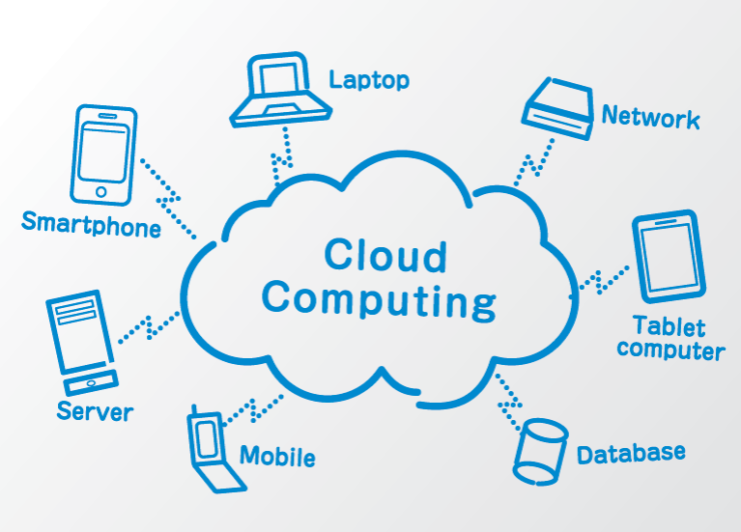
CLOUD COMPUTING
PERFORMANCE MODELING AND SUITABILITY ASSESSMENT OF DATA CENTER BASED ON FOG COMPUTING
Computing based on the internet
Users can access files
Use applications from any device
Pay-per-use business model
Making all of the connected devices work together
Performs complex computation
Courtesy: https://www.terminalworks.com/blog/fog-computing
Notes:
Google pic mathi url , subpoint . mathi

Slide 6
CHALLENGES
PERFORMANCE MODELING AND SUITABILITY ASSESSMENT OF DATA CENTER BASED ON FOG COMPUTING
Network bandwidth constraints
Slower Response time
Higher Latency
Absence of location awareness

Slide 7
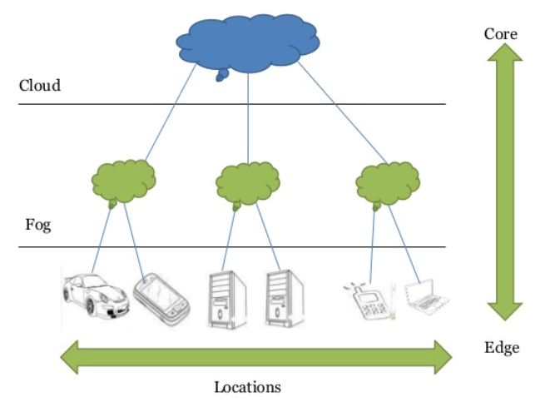
FOG
PERFORMANCE MODELING AND SUITABILITY ASSESSMENT OF DATA CENTER BASED ON FOG COMPUTING
Fog computing or fogging is a term coined by CISCO
Extend the cloud nearer to IOT devices
Intermediate layer between cloud and devices
Acts as a middleware
Fog = IOT + Cloud
Courtesy: https://www.terminalworks.com/blog/fog-computing

Slide 8
WHY FOG?
PERFORMANCE MODELING AND SUITABILITY ASSESSMENT OF DATA CENTER BASED ON FOG COMPUTING
Less bandwidth and volume
Dense geographical distribution
Reduced service latency and congestion

Slide 9
WHY FOG?
PERFORMANCE MODELING AND SUITABILITY ASSESSMENT OF DATA CENTER BASED ON FOG COMPUTING
Improves QOS
Enhanced User Experience
Proximity to its end users

Slide 10
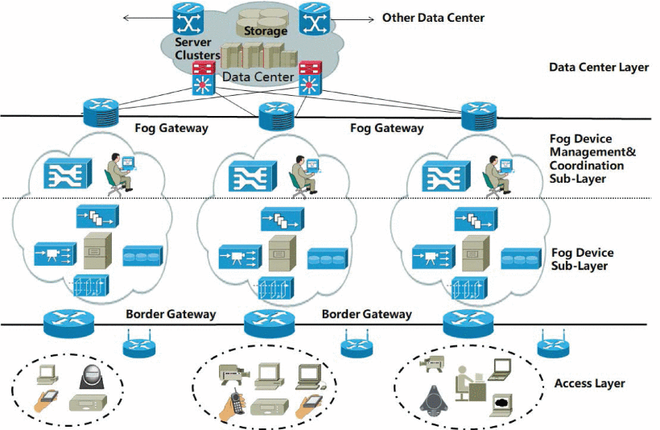
THREE TIER ARCHITECTURE
PERFORMANCE MODELING AND SUITABILITY ASSESSMENT OF DATA CENTER BASED ON FOG COMPUTING
Courtesy: https://ieeexplore.ieee.org/document/8368197

Slide 11
THREE TIER ARCHITECTURE(cont..)
PERFORMANCE MODELING AND SUITABILITY ASSESSMENT OF DATA CENTER BASED ON FOG COMPUTING
TERMINAL ACCESS LAYER
Sensors ,Smart watch , Mobile , IOT devices
Service request =>Border gateway

Slide 12
THREE TIER ARCHITECTURE(cont..)
PERFORMANCE MODELING AND SUITABILITY ASSESSMENT OF DATA CENTER BASED ON FOG COMPUTING
FOG COMPUTING LAYER
Fog device sub-layer
Fog nodes
Decision Making
Faster response time
Semi permanent storage
Data compression
Redundancy elimination

Slide 13
THREE TIER ARCHITECTURE(cont..)
PERFORMANCE MODELING AND SUITABILITY ASSESSMENT OF DATA CENTER BASED ON FOG COMPUTING
Fog device management and coordination sub-layer
Includes device manager server
Monitors
Ability of fog device
Usage of resources
State information in real time
Fog gateway devices=> fog to cloud
Notes:
Improves extensibility and fault tolerance

Slide 14
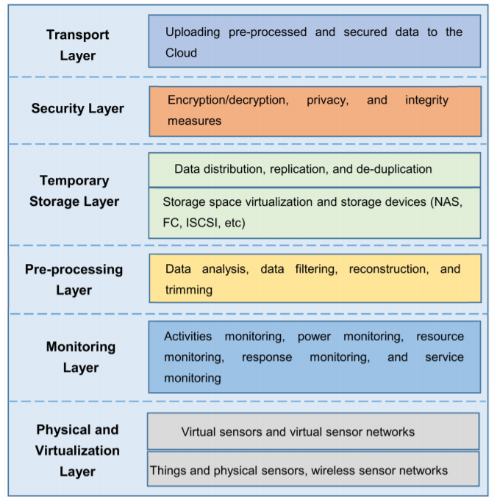
THREE TIER ARCHITECTURE(cont..)
PERFORMANCE MODELING AND SUITABILITY ASSESSMENT OF DATA CENTER BASED ON FOG COMPUTING
Courtesy:https://ieeexplore.ieee.org/document/8368187
Notes:
n/w attached s/m, fibre channel, internet small computer system interface

Slide 15
THREE TIER ARCHITECTURE(cont..)
PERFORMANCE MODELING AND SUITABILITY ASSESSMENT OF DATA CENTER BASED ON FOG COMPUTING
CLOUD DATA CENTER LAYER
High performance servers
Complicated computations
Permanent storage
Analysis with historical data

Slide 16
FOG ENABLERS
PERFORMANCE MODELING AND SUITABILITY ASSESSMENT OF DATA CENTER BASED ON FOG COMPUTING
Virtualization
One physical server to run individual computing environments
Virtual Technologies
Hypervisor(Virtual Machine Monitor)
Computer software
Generates and runs the VM
Docker
Deployment of applications inside application containers
Run multiple process like VM
Notes:
Server,client,storage

Slide 17
EFFECTS OF TECHNOLOGY(cont..)
PERFORMANCE MODELING AND SUITABILITY ASSESSMENT OF DATA CENTER BASED ON FOG COMPUTING
QOE
Measurement of service provided by fog nodes
Customer-centric
Calculated using UEM(user expectation metrics)
Required resources
Processing time
Data accessing

Slide 18
EFFECTS OF TECHNOLOGY(cont..)
PERFORMANCE MODELING AND SUITABILITY ASSESSMENT OF DATA CENTER BASED ON FOG COMPUTING
QOS
Overall performance of a service
Basic standard should be maintained
Factors
Reliability
Security
Performance
Adaptability

Slide 19
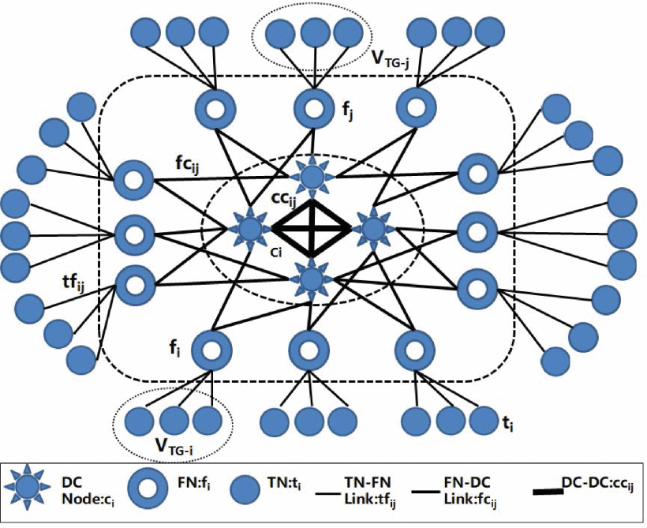
NETWORK MODELING
PERFORMANCE MODELING AND SUITABILITY ASSESSMENT OF DATA CENTER BASED ON FOG COMPUTING
Courtesy: https://ieeexplore.ieee.org/document/8368197

Slide 20
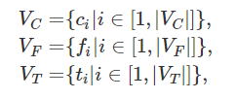



NETWORK MODELING
PERFORMANCE MODELING AND SUITABILITY ASSESSMENT OF DATA CENTER BASED ON FOG COMPUTING
In set G={V,E}

Slide 21



NETWORK MODELING(cont..)
PERFORMANCE MODELING AND SUITABILITY ASSESSMENT OF DATA CENTER BASED ON FOG COMPUTING
Data centers are connected directly through OTN.
transport, multiplexing, switching, management, supervision
Data center nodes - every vertex is reachable from every other
Notes:
Limited bw

Slide 22
SERVICE TYPES IN SMART SYSTEMS
PERFORMANCE MODELING AND SUITABILITY ASSESSMENT OF DATA CENTER BASED ON FOG COMPUTING
CIS
Intensive computing with high performance servers
Example-Video surveillance image
STS
Semi permanent storage of data uploaded by terminal
Energy consumption in storage processing are small
Example- Real time services by sensors
SS
Support dedicated services logic processing
Example- Virtual desktop services, VM or Containers
Notes:
service data storage services

Slide 23
PERFORMANCE INDICATORS
PERFORMANCE MODELING AND SUITABILITY ASSESSMENT OF DATA CENTER BASED ON FOG COMPUTING
Network Load
Data compression in fog
involves encoding information using fewer bits than the original representation.
Implements Lossless compression
reduces bits by identifying and eliminating statistical redundancy
Compression ratio(ɸ) – ratio of service request processed by data center

Slide 24
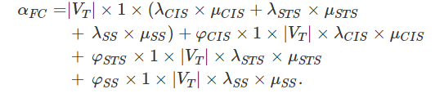
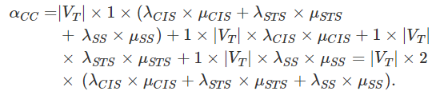
PERFORMANCE INDICATORS(cont..)
PERFORMANCE MODELING AND SUITABILITY ASSESSMENT OF DATA CENTER BASED ON FOG COMPUTING
New data center
Traditional data center

Slide 25
PERFORMANCE INDICATORS(cont..)
PERFORMANCE MODELING AND SUITABILITY ASSESSMENT OF DATA CENTER BASED ON FOG COMPUTING
Service Latency
Transmission Delay
time it takes to push the packet's bits onto the link
Queuing delay
time the packet spends in routing queues
Processing delay
time routers take to process the packet header
Propagation delay
time for a signal to reach its destination

Slide 26
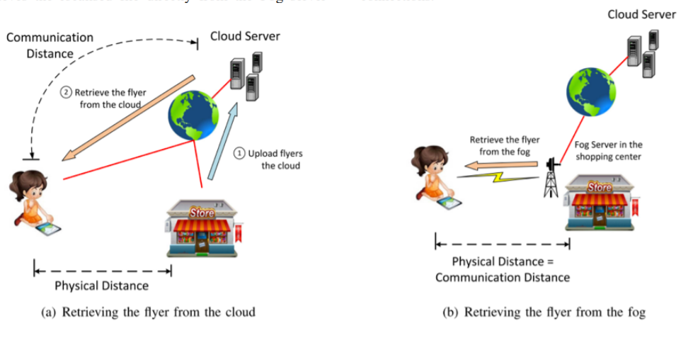
PERFORMANCE INDICATORS(cont..)
PERFORMANCE MODELING AND SUITABILITY ASSESSMENT OF DATA CENTER BASED ON FOG COMPUTING
Courtesy:https://ieeexplore.ieee.org/document/8368189

Slide 27
PERFORMANCE INDICATORS(cont..)
PERFORMANCE MODELING AND SUITABILITY ASSESSMENT OF DATA CENTER BASED ON FOG COMPUTING
Latency - The time from the source sending a packet to the destination receiving it
Bandwidth - Maximum throughput of a logical or physical communication path
Changes in Latency or changes in Bandwidth will affect the amount of time required for a set of data to travel from point A to point B.
B ∝ (1/τ)
Latency and bandwidth define the speed and capacity of a network

Slide 28
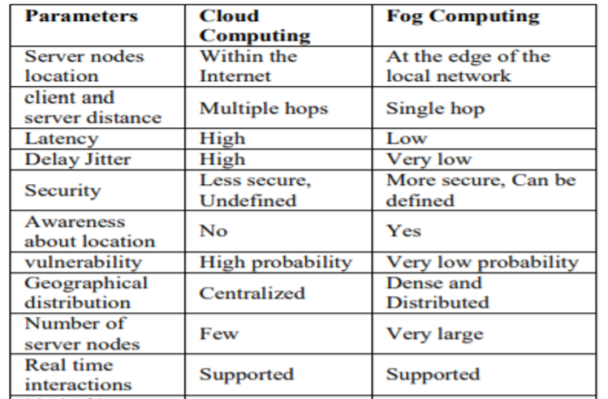
COMPARISON
PERFORMANCE MODELING AND SUITABILITY ASSESSMENT OF DATA CENTER BASED ON FOG COMPUTING
Courtesy:https://ieeexplore.ieee.org/document/8368189

Slide 29
APPLICATIONS
PERFORMANCE MODELING AND SUITABILITY ASSESSMENT OF DATA CENTER BASED ON FOG COMPUTING
Decision making algorithm in smart health monitoring
N number of health attribute values, prefixed the threshold value for each attribute
current state of patient
Determine attributes for current context
Calculate DOI
IF(DOI VALUE IN ABNORMAL RANGE) THEN STATE=Unsafe
Else State=safe
Return state
Trigger Event _Occurrence=True
Generate early warning signal to responder
Send vital data to cloud storage for analysis

Slide 30
APPLICATIONS(cont..)
Connected Vehicles
Connectivity and interactions :cars to cars, cars to access points, access points to access points
Attributes of fog helps in CV
Location awareness
Mobility
Real time interactions
Low latency

Slide 31
CONCLUSION
The data produced by IOT is huge
Cloud have limitations in real time applications
Fog extends cloud services
Fog is more efficient in case of high performance devices
Bottom up three tier architecture helps to reduce latency, conserves bandwidth
Performance model of new data center using fog is better than traditional data center

Slide 32
REFERENCES
1. Y. Yan, Y. Qian, H. Sharif, D. Tipper, "A survey on smart grid communication infrastructures: Motivations requirements and challenges", IEEE Commun. Surveys Tuts., vol. 15, pp. 5-20, 1st Quart 2013.
2. F. Ye, Y. Qian, R. Q. Hu, "Energy efficient self-sustaining wireless neighborhood area network design for smart grid", IEEE Trans. Smart Grid, vol. 6, no. 1, pp. 220-229, Jan. 2015.
3. P. Verma, S. K. Sood, "Fog assisted-IoT enabled patient health monitoring in smart homes", IEEE Internet Things Journal
4. S. M. Alzahrani, "Sensing for the Internet of Things and its applications", Proc. 5th Int. Conf. Future Internet Things Cloud Workshops (FiCloudW), pp. 88-92, Aug. 2017.
5. A. Sivanathan, D. Sherratt, H. H. Gharakheili, V. Sivaraman, A. Vishwanath, "Low-cost flow-based security solutions for smart-home IoT devices", Proc. IEEE Int. Conf. Adv. Netw. Telecommun. Syst. (ANTS), pp. 1-6, Nov. 2016.

Slide 33
THANK YOU

